Slide 1
BA870
Final Project
Yilun Wang: yilun830@bu.edu

Slide 2
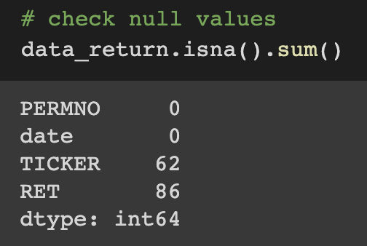
Risk Exposures
Data: Tickers and RetYTD have 1886 values.
RetYTD are objects. I converted it to floats.
After converting, RetYTD have 86 null values.
Ignored missing values in TICKER. No null values in FF factors dataset.
Mean: 0.0177, std:0.1557.
Fill them with 0.
After data cleaning, 114,715 entries.
Originally, 60*1886=113,160.

Slide 3
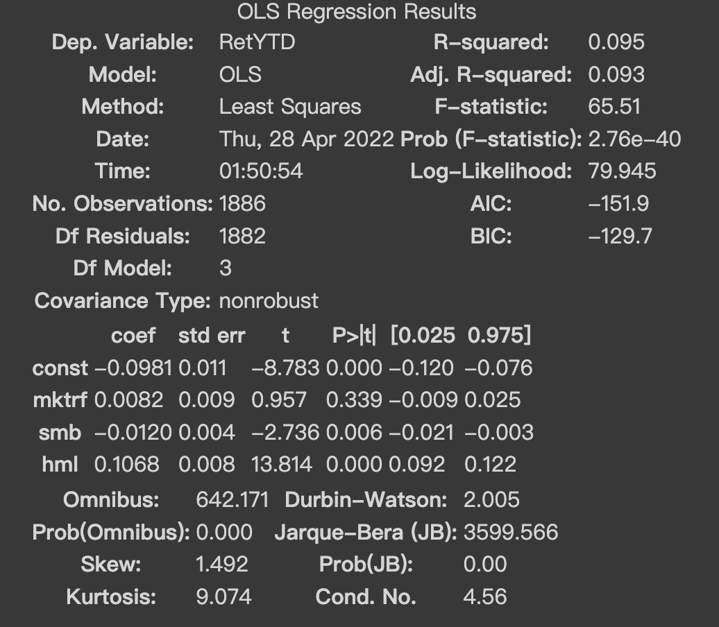
Risk Exposures
R-squared: 0.095
Adj.R-squared: 0.093
Mktrf’s p-value bigger than 0.05
Coefficient of risk exposure:
- Market : 0.0082
-Size : -0.0120
-Value : 0.1068

Slide 4
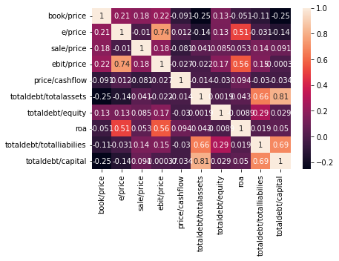
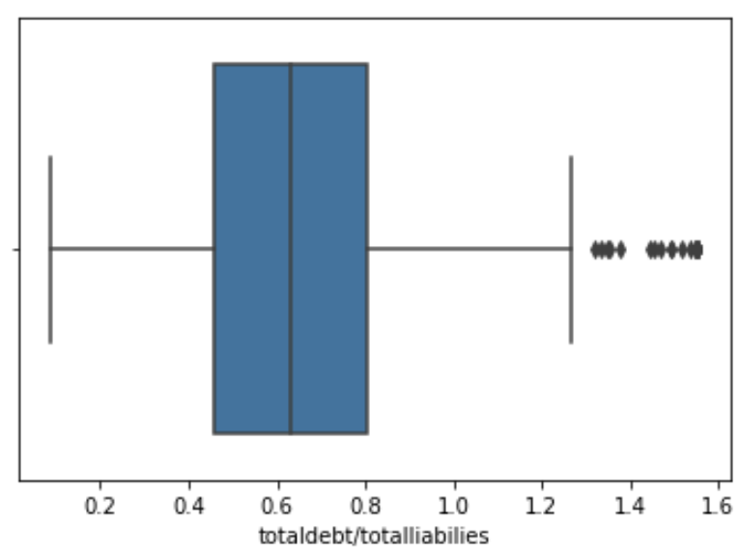
Financial ratios
Ratios:
Data: 1886 values
Missing values in :
-price/cashflow: 1
-totaldebt/totalassets: 237
-totaldebt/equity: 5
-totaldebt/totalliab: 5
-totaldebt/capital: 237
Winsorize + average value

Slide 5
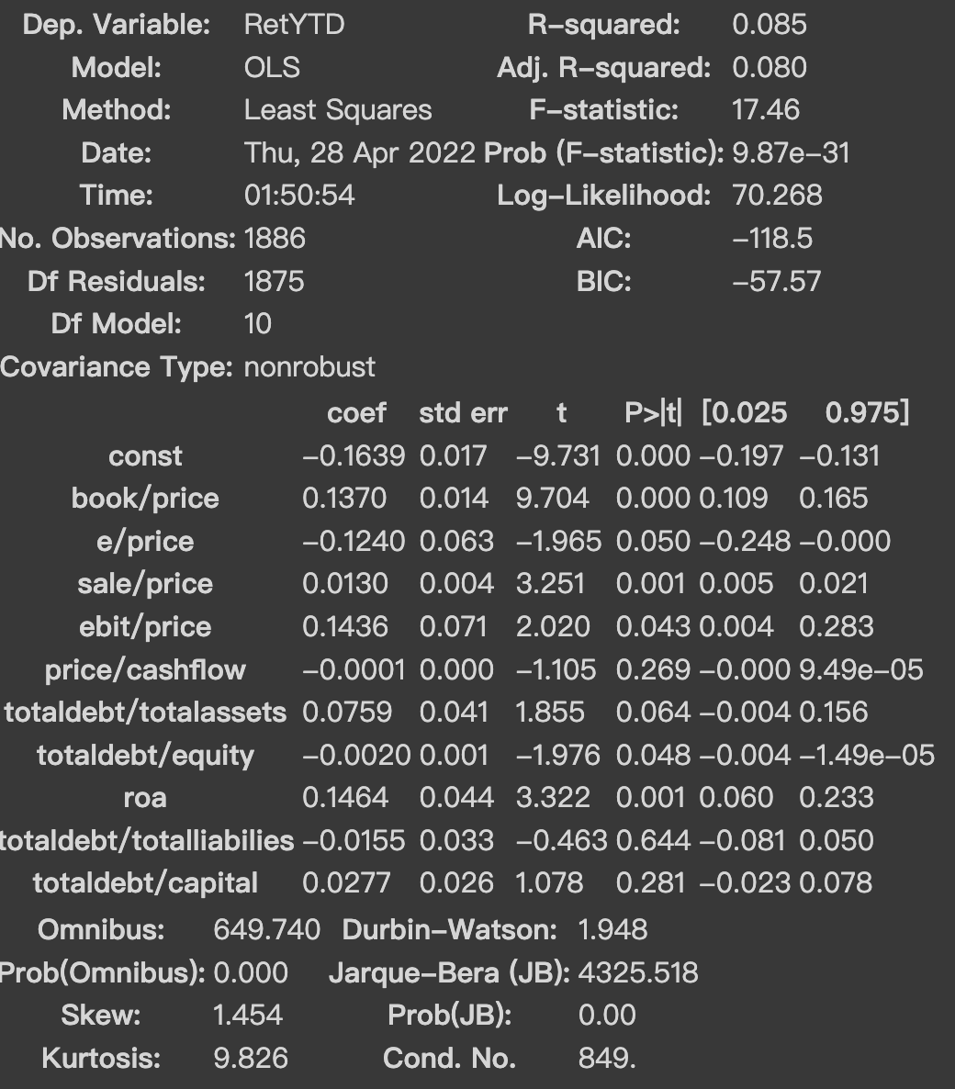
Financial ratios
R-squared: 0.085
Adj.R-squared: 0.080
Coefficient: 6 positive + 4 negative

Slide 6
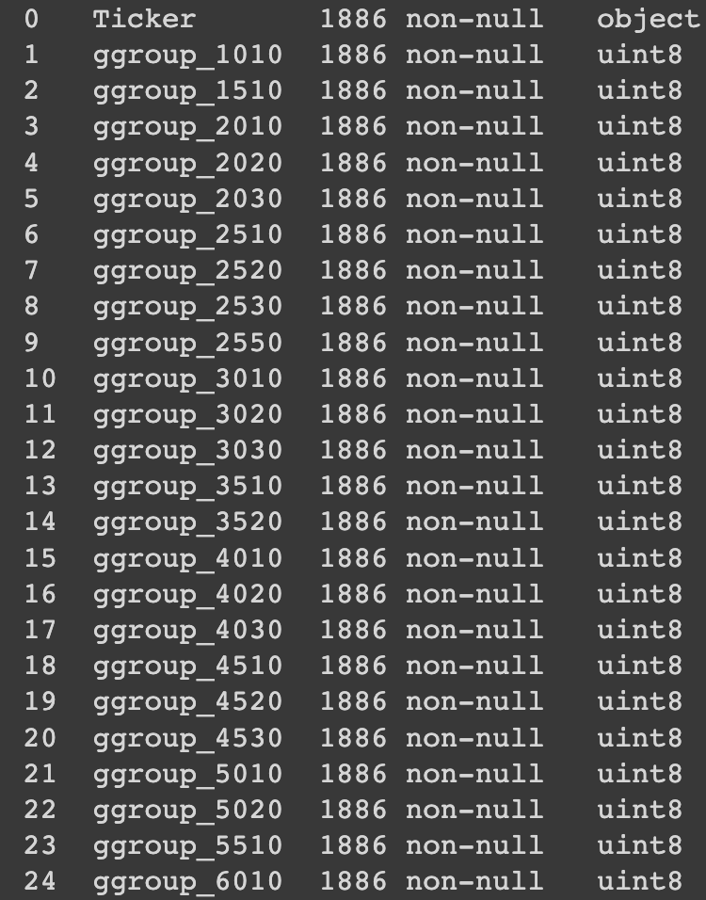
Industries
Data: 1886 values
No null value.
After get dummies, 25 columns.

Slide 7
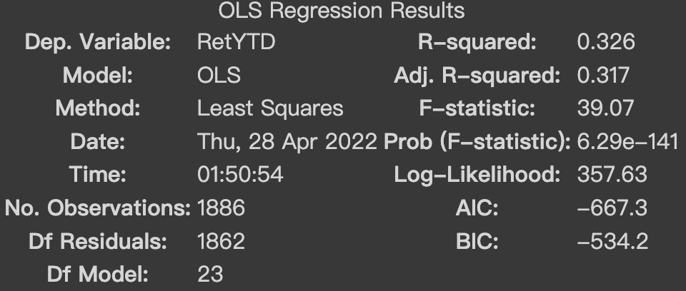
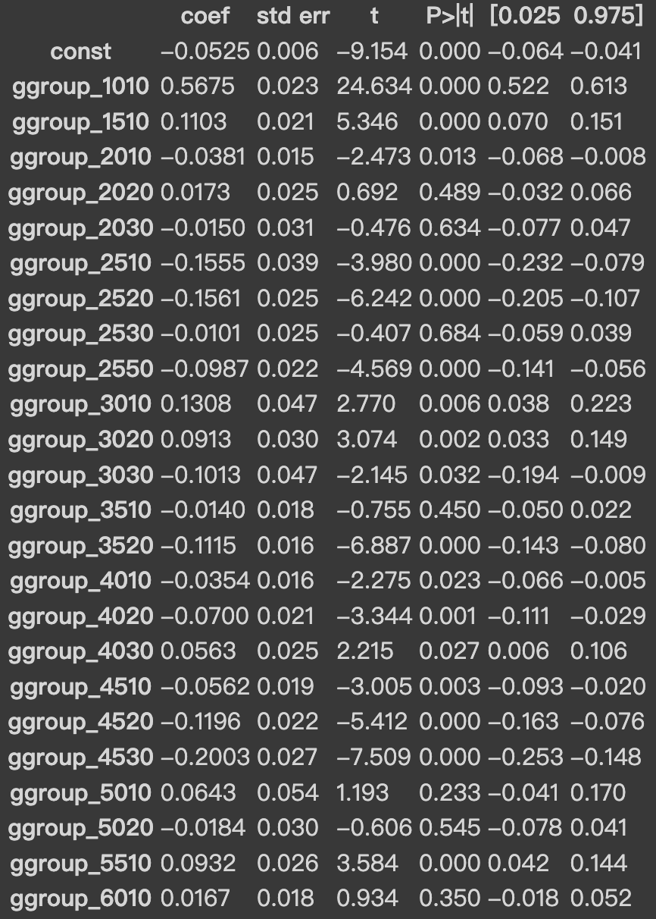
Industries
R-squared: 0.326
Adj.R-squared: 0.319
Coefficient:
9 positive + 15 negative

Slide 8
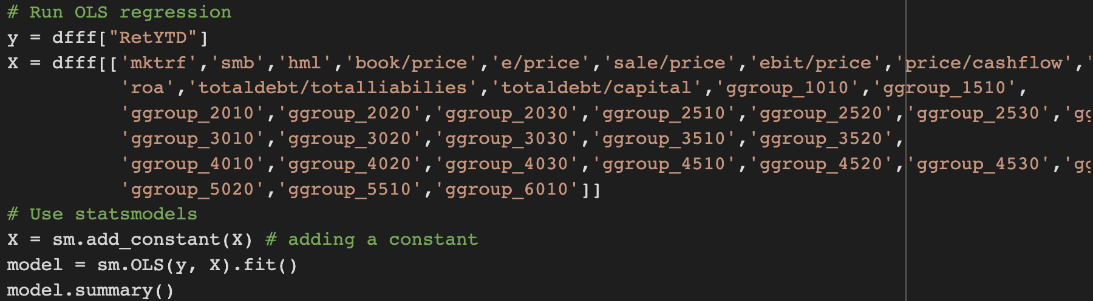
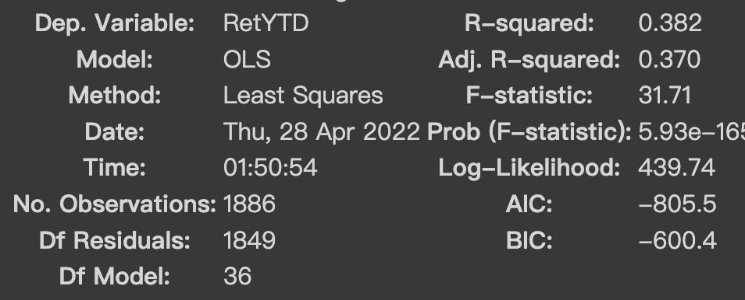
Combination
After combination:
R-squared : 0.0382
Adj.R-squared : 0.0370
Number of positive and negative coefficients did not change too much.

Slide 9
End
THANK YOU!!

